Slide 1




Prescribing Development
Framework Launch
Expanding Prescribing in Community Pharmacy
FUNDED BY
DELIVERED IN PARTNERSHIP WITH

Slide 2



Expanding Prescribing
in community pharmacy
Professionals' and patients' views
Lorna Jacobs
Communities and Insights Lead, Thiscovery
September 2026

Slide 3



The research
Aim: a practical, multi-stakeholder evidence base to inform a national Framework for prescribing in community pharmacy
NPA commissioned it; Thiscovery designed and delivered it with NPA and Q; Q led the Framework
Three linked online surveys; 482 participants in total
219
187
76
219
Community pharmacists
Patients
Other prescribing professionals
& commissioners
50% hold an IP qualification, of these:
  68% are actively prescribing
  32% not actively prescribing
51% aged over 65
Majority (44%) visit a pharmacist about once a month
64 Clinical prescribers/managers
12 Commissioners/service planners
Both professional groups asked about: views on expanding IP (value & barriers); how services work together; and commissioning. Questions nuanced to each background.
Asked about: awareness, comfort and concerns about pharmacists’ prescribing

Slide 4
Headline insights
The gap is not ambition. It's infrastructure.
There was a consistent picture across all three groups: strong support for expansion, and clear gaps in the infrastructure, workforce training capacity and professional relationships.
84% of pharmacists
agree expansion would improve access, and that the NHS should fund it as standard primary care
Only 30% of pharmacists
feel current infrastructure is actually ready for scale - the aspiration-readiness gap
68% of patients
already knew pharmacists could prescribe; 70% hadn't tried it but would be happy to
64% of other professionals
agree expansion would improve access, but 74% of clinical prescribers say the workforce isn't ready yet
58% of qualified pharmacists want peer learning and clinical supervision to build confidence, but securing a Designated Prescribing Practitioner is a critical training bottleneck
Only 8% of other professionals
report a strong, well-working multi-disciplinary prescribing team and 42% say different prescribers currently work entirely separately

Slide 5
Reflections: agreements and differences
What everyone agrees on
Where they differ
Integrated IT with patient records access
Sustainable NHS funding
Clear clinical pathways with governance
Patients validate the offer: 86% would see a pharmacist if their GP surgery was closed
No meaningful disagreement on what safe, scaled prescribing needs
Pharmacists: fund it and build the infrastructure, our competence is already there
Other professionals: demonstrate competence and governance first, then fund it
Commissioners: none report a well-established service; they want proof of competence before they commit
Patients: ready and positive, but trust is conditional on visible training, privacy and records access

Slide 6
In their own words
Community pharmacists
Other professionals
Patients
“Funding. If there is funding available to pharmacies for partaking in prescribing services, everything else will follow. This will enable more pharmacies to utilise skills they already have and change the way of working”
“Fully endorse it. It is amazing. Surgeries love it, patients love it, our pharmacists love it.”
“I would want a private discussion always not an over the counter one. I would like to know how my records will be updated and how quickly they reference the discussion and the subsequent prescription.”
"From my experience training independent pharmacist prescribers … there is a significant minority who are over-confident in their clinical abilities, they don't know what they don't know… there is a risk that if we try to roll out independent prescribing too fast, too soon, it has the potential to negatively impact patient care."
“For everyday conditions like sore throat, cold etc I think a pharmacist is good enough … But for a new or more complex condition I think I would always feel more comfortable discussing with a GP.”
“GP-pharmacist relationship — sort that and the rest will follow. It's personal relationships that get things done.”

Slide 7
Convening groups response to findings
15 July 2026, The Royal Society of Medicine convening event: 29 stakeholders from pharmacy, primary care, NHS England and the devolved nations, and patient group representatives.
Generally recognised as accurate: Findings resonated with day-to-day reality across the room. Gap is between professional and public readiness, and is more of a trust and visibility problem, rather than a competence gap.
Patients and Pharmacy First: Convenience is valued, but awareness has been a ‘flash in the pan’. Privacy of consultations and pharmacy closures were raised as real risks to the ambition itself.
A caution on sample size: Several attendees felt 15 GP respondents was too small a base to be definitive, and asked for further recruitment of GPs, patients and other professionals before wider use.

Slide 8
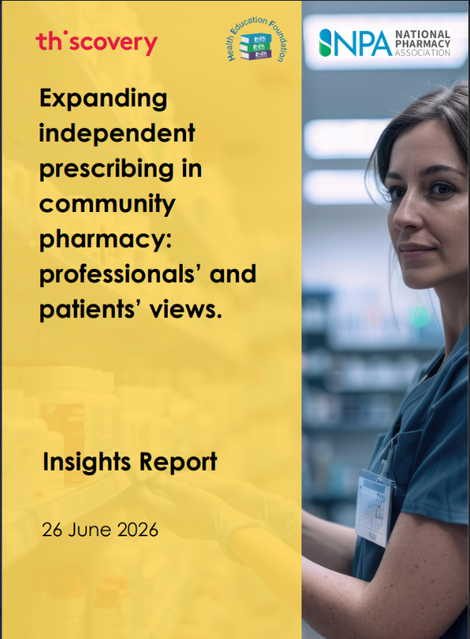
See the Insights Report for full details of survey methods and findings
Email lorna.jacobs@thiscovery.org

Slide 9


Slide 10

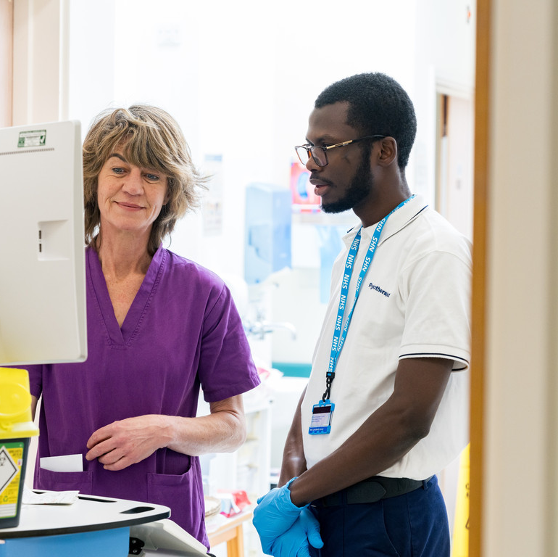
Creating the Conditions for Safe Prescribing
A framework for expanding prescribing in community pharmacy
September 2026

Slide 11
Why this matters now
A pivotal moment for prescribing - but system readiness hasn't kept pace
From September 2026, all newly qualified pharmacists enter the register as independent prescribers, and thousands of existing pharmacists are gaining this qualification too.
Access still varies by geography, and the conditions needed to support safe prescribing are inconsistently in place.
Without a shared, structured way to close this gap, expansion risks happening unevenly across the UK.
Patients and professionals consistently link safe expansion to visible conditions being in place - not to prescribing rights alone.
Where these conditions exist today, it is often through individual initiative and local goodwill rather than system-wide support, meaning what a patient experiences can still vary depending on where they live.

Slide 12
What the framework is and how it was built
The framework identifies the conditions needed for prescribing to expand safely and sustainably, providing UK consistency while allowing local flexibility in how conditions are met.
A shared, evidence-based framework, not a top-down mandate
Evidence base
Three linked surveys of 482 pharmacists, other professionals and patients (NPA, Thiscovery, Q Community, 2026).
Tested and refined at a roundtable of 29 stakeholders, 15 July 2026, spanning community pharmacy, primary care, NHS England, devolved nations, and patient representative bodies.
Shaped by national policy direction, NHS England's commissioning guidance, Pathfinder evaluation and devolved-nation experience.
Draws on two established systems-change models - Six Conditions for Systems Change and Donella Meadows' Places to Intervene - reflecting the view that lasting change depends on relationships and culture, not structural fixes alone.
Who it's for
UK policymakers and decision-makers, sector decision-makers across community pharmacy, and local system commissioners and primary care leaders.

Slide 13
How it will help and how to use it
The framework identifies the conditions needed for independent prescribing to expand safely and sustainably, providing UK consistency while allowing local flexibility in how conditions are
How to use it
Start with the model at a glance
Use the three condition sections to identify gaps relevant to your role
Apply the maturity matrix to track system-level progress over time
Use the balanced scorecard to consider measures that will help assess outcomes
Refer to the appendices for case studies and practical resources.
What it gives you
    A shared language for discussing what's working and what isn't, across the UK.
    A way to identify specific gaps and priorities within structural, relational and confidence conditions, informing policy, investment and commissioning decisions.
    UK-wide consistency in what matters, while allowing local systems flexibility in how conditions are met.
    A basis for ongoing, system-level assessment through the maturity matrix, and continuous improvement through embedded feedback loops.
A shared language for closing the readiness gap - used differently depending on your role

Slide 14
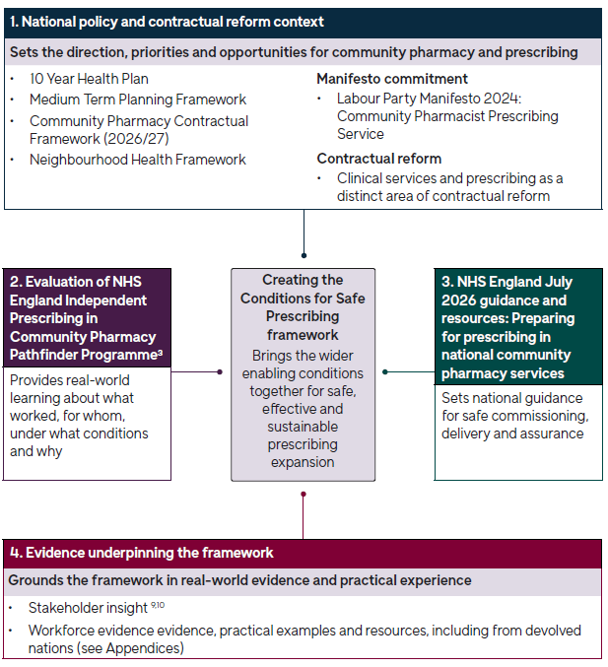
How the framework fits within wider policy and evidence base
The framework sits within a wider evidence and policy ecosystem - grounded in national policy direction and NHS England's commissioning guidance, and informed by Pathfinder evaluation, stakeholder insight and real-world implementation.

Slide 15
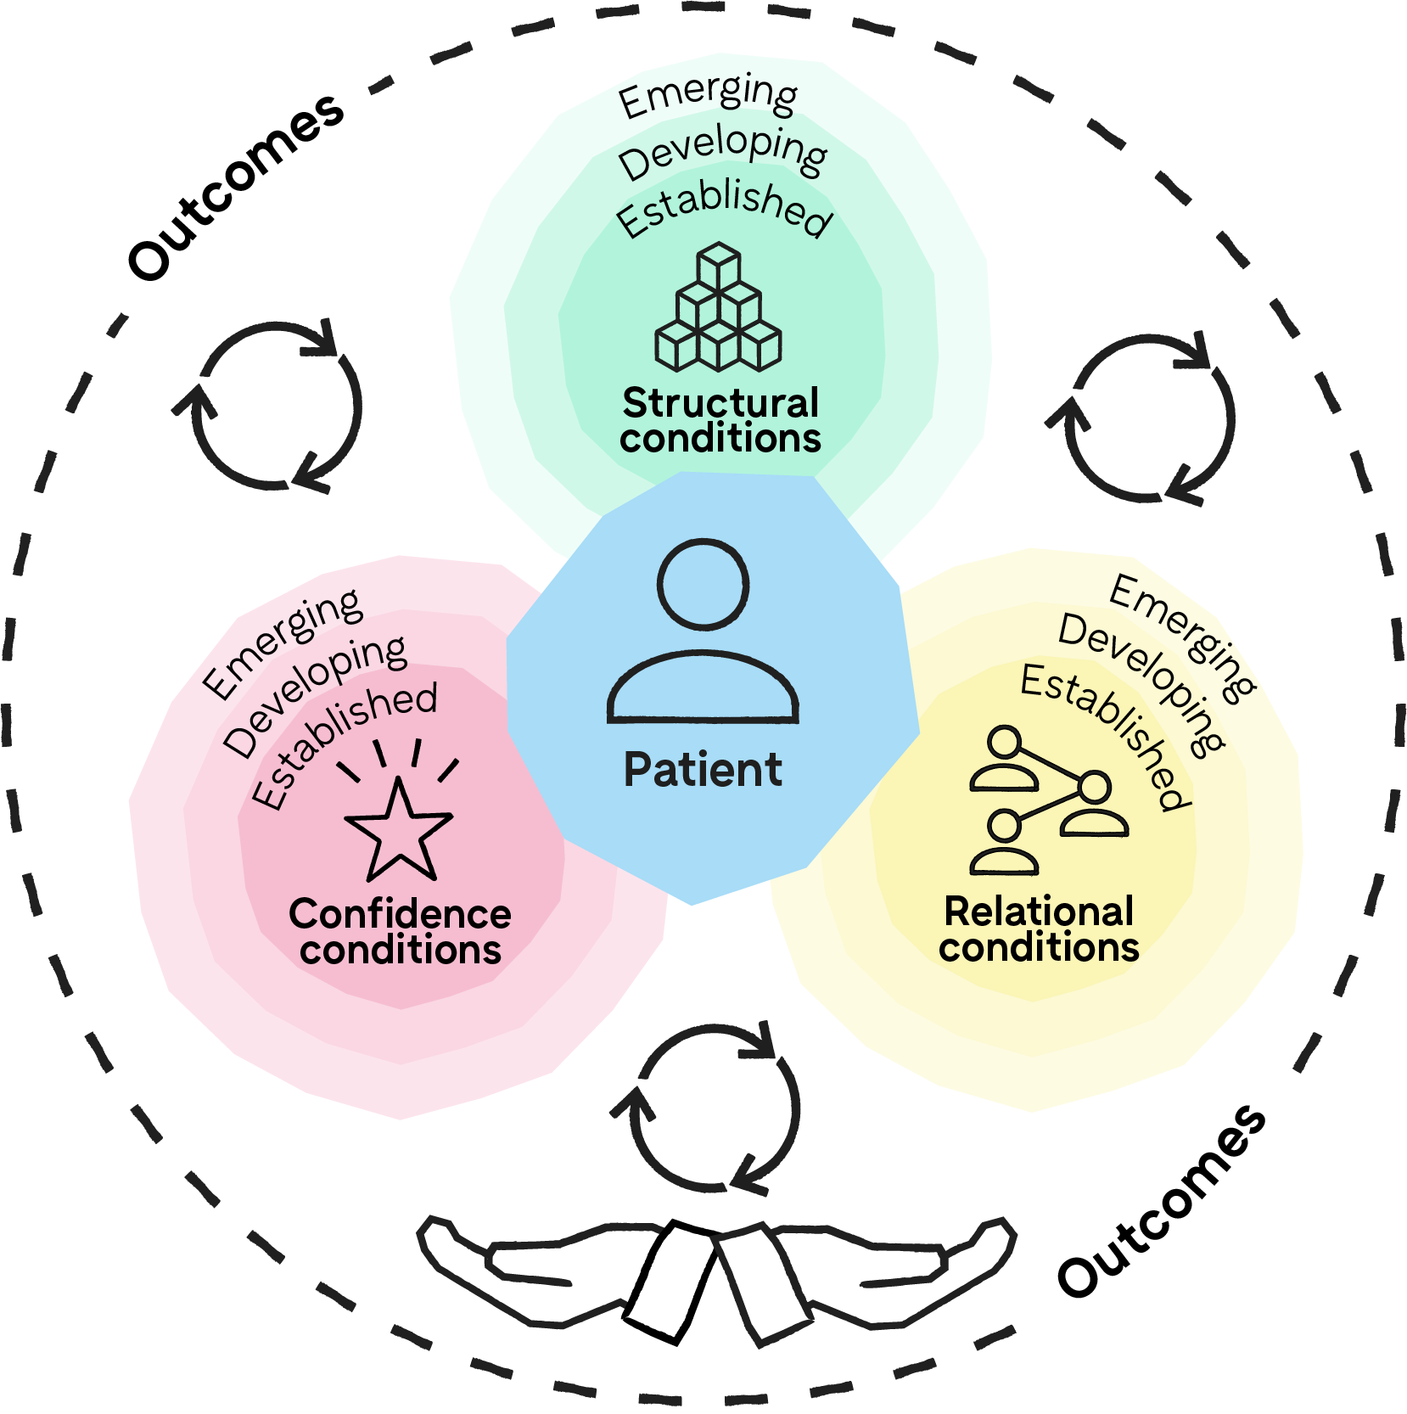








Framework at a glance
Patient: Needs, safety and voice at the heart of every decision.
Maturity: Confidence, structural and relational conditions vary in how developed they are across the system.
Structural conditions: Systems, records and infrastructure that enable safe prescribing.
Implementation: Flexible implementation support helps teams put these conditions into practice in ways that suit their local context.
Relational conditions: Collaboration and trust between pharmacy, general practice and the wider system.
Learning: An ongoing cycle of learning, so conditions improve as the system evolves.
Confidence conditions: Confidence in professionals’ skills, and in the system that supports them.
Outcomes: Focused on what matters most to patients, professionals and the system.

Slide 16
Structural conditions
The visible scaffolding that makes safe prescribing possible at scale
Without the right foundations, prescribing depends on individual initiative and goodwill — meaning what a patient experiences varies by postcode rather than need. Structural fixes are necessary, but evidence from systems-change thinking shows they are rarely sufficient alone.
Category | Includes
Prerequisites before prescribing begins | Capacity (workforce and skill mix IT and records access Governance and safety infrastructure Premises and consultation space
Ongoing core standards | Funding and commissioning Clinical pathways and referral routes Service specifications and contract alignment
Requirements that vary by context | Designated Prescribing Practitioner (DPP) capacity and supervision.
More advanced capability | Full IT integration

Slide 17
Relational conditions
Relationships turn structural foundations into safe, joined-up care in practice
Where GP–pharmacy relationships are strong, prescribing works well and patients experience continuity; where they are weak or absent, prescribers can end up isolated, limiting safety and scope. The GP–pharmacy relationship is the core relational condition, underpinned by consistent, system-supported ways of working.
This includes:
    Communication and information-sharing
    Two-way referral and escalation
    Access to clinical advice
    Handover and follow-up
    Feedback loops
    Shared understanding of roles and scope
    Joint learning and development
    System support for collaboration

Slide 18
Confidence conditions
Confidence is earned and sustained - not created once, at the point of qualification
Even where funding is in place and relationships are strong, prescribing will not be trusted at scale unless patients and professionals can see it is safe, competent and properly overseen. Confidence must be actively supported as a pharmacist moves from newly qualified prescriber into active, sustained practice.
This includes:
    Building prescriber confidence through:
    Supervision
    Peer support
    Continuing professional development
    Access to advice
    Visible signals that build confidence in others through:
    Visible training, qualifications and scope
    Governance, oversight and escalation
    Records, follow-up and GP communication
    Safe consultation environments
    Staged expansion and earned trust

Slide 19
Maturity matrix: Assessing system level progress
 | Emerging | Developing | Established
Structural conditions | Patients experience gaps in continuity where systems work around incomplete records and inconsistent pathways. | Patients generally experience continuity as systems establish clearer pathways, though funding and IT can still feel inconsistent across providers. | Patients experience the same safe, joined-up care across the system, within sustainable funding and integrated infrastructure.
Relational conditions | Patients' experience depends on whether individual pharmacists and GPs happen to have a good relationship, built on local goodwill. | Patients increasingly see pharmacy and general practice working as one team, supported by system-wide training and referral norms | Patients experience seamless collaboration as standard, within a system that actively incentivises and sustains it.
Confidence conditions | Patients may be unaware pharmacists can prescribe, while trust is built case by case without visible system-wide support. | Patients are told clearly about training and given privacy, as the system develops clearer governance and growing peer support. | Patients trust pharmacist prescribing as safe and familiar, backed by system-wide outcome data and visible support structures.
Notes:
The matrix assesses system-level deployment of community pharmacy prescribing, not individual pharmacists or pharmacies.
It is an early, developing tool - a starting point for shared reflection, to be refined as it is tested in practice.

Slide 20
Balanced scorecard
A complementary way to measure whether outcomes are being delivered, not just conditions met.
The maturity matrix tracks progress in establishing the conditions for prescribing.
The balanced scorecard tracks whether that progress is translating into results - bringing together measures across four perspectives.
The scorecard is intended as a starting point for further development.
People and capability - workforce capability, confidence and support needed for safe prescribing.
Delivery, integration and governance - how widely services are implemented, how safely they run, and how well they connect into wider care.
Patient experience and outcomes - whether patients can access timely care, experience safe and trusted services, and achieve good outcomes.
System value - the contribution of pharmacy prescribing to NHS capacity, efficiency and reduced duplication of care.
Together, these four perspectives show whether capability, delivery, patient impact and system value are developing in step - not just whether individual conditions are being met.

Slide 21
Real world application
Prescribing is already operating at scale across the UK, in different service models.
Scotland
Pharmacy First reached 4.2 million consultations in 2023 alone; NHS Pharmacy First Plus now offered by around 400 of Scotland's 1,258 community pharmacies, backed by national funding and Teach and Treat clinical development
Wales
Choose Pharmacy freed up almost 26,000 GP appointments in a single month; the Pharmacy Independent Prescribing Service grew from 192 sites (2023/24) to 271 sites (2024/25), combining national standards with formal scope-expansion routes
England (Pathfinder)
33,000+ consultations across 197 pharmacies and 40 ICBs; 97% resolved without onward referral; 55% of activity would otherwise have happened elsewhere. Evans Pharmacy, East Leake extended an existing GP-referral pathway, cutting onward referral to under half the rate seen with Pharmacy First alone

Slide 22
Priority areas requiring further development
The NPA Prescribing Development Programme has begun to create and curate a broad set of practical materials to support independent prescribing.
Further collaborative input is needed to support prescribing to expand safely and sustainability.
Area | What's needed
Implementation support | Clarity on who helps local sites put conditions into practice day to day; strong support for a UK-wide minimum offer.
Learning | Peer support and protected learning time for newer prescribers, given pressure on DPP capacity.
Outcomes | A defined layer describing system-level benefit and how success will be measured - specific measures still to be developed.
Patient voice | An explicit, ongoing feedback mechanism that patients help design, not just get consulted on.
Awareness and alignment | Continued alignment with the NHS 10 Year Plan and wider UK policy, and ongoing work to raise awareness.

Slide 23
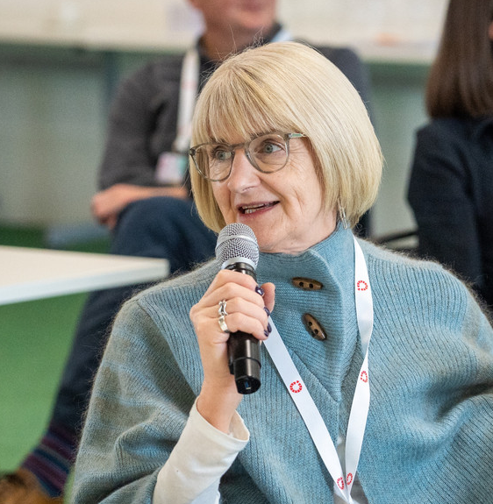
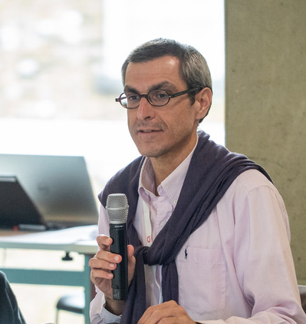
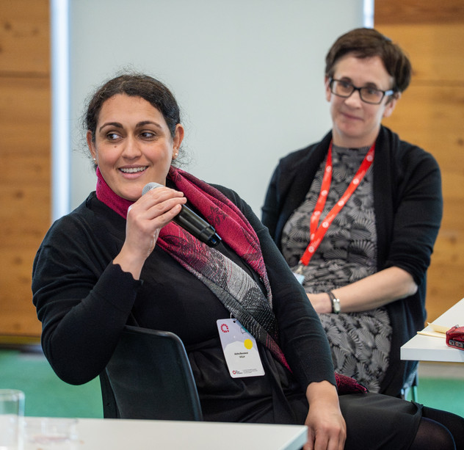

About Q
  Everyone should have access to high quality health care. Right now, they don’t. We know there are thousands of people working hard to change this. But without connections between them, we lose ideas and energy needed to solve the complex challenges we face. In the Q community, we learn, share and collaborate to address pressing health system challenges. By sharing insight, skills, and ideas widely, we create the culture and conditions for improvement efforts to succeed.
  Together, we make faster progress to improve health and care for everyone, every day
  Visit us online: q.thenhsalliance.org
  Email us: Q@thenhsalliance.org

Slide 24
Thank you
Q is hosted by The NHS Alliance and supported by the Health Foundation and partners across the UK and Ireland
18 Smith Square, London, SW1P 3HZ
q@thenhsalliance.org
q.thenhsalliance.org

Slide 25

Community Pharmacy
Prescribing Development
Roadmap
The way forward
Presented by
Dr. Lem Ngongalah & Michael Lennox

Slide 27
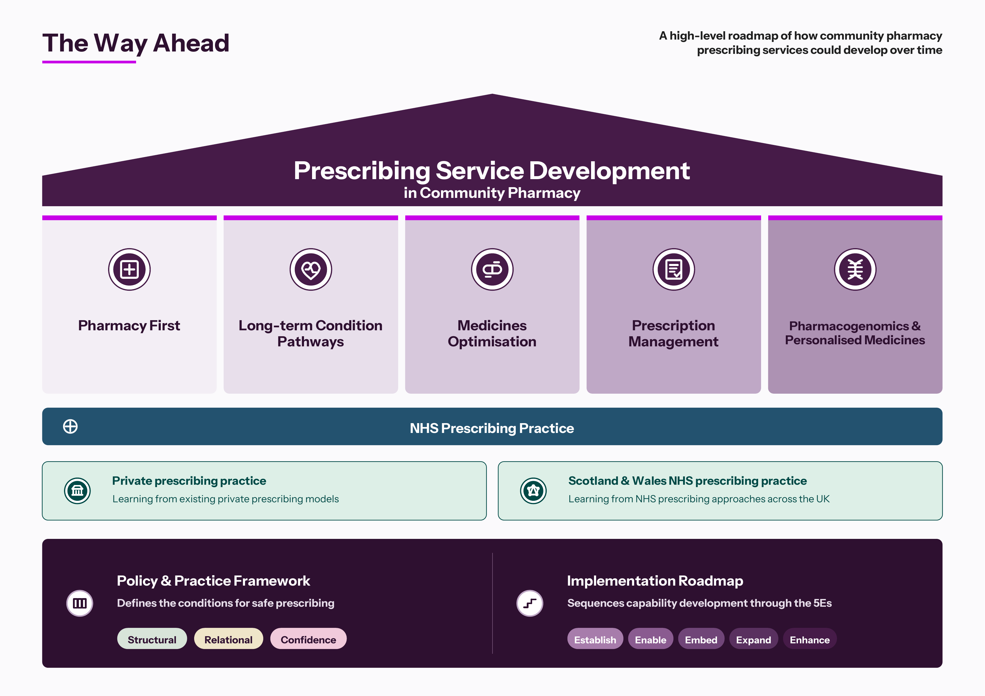

Slide 28
THANK YOU

